Slide 1
Google Maps: A Study on Restaurants in PA
Zimeng Liu 05/08/2023

Slide 2
Problem Statements
Learn more about restaurants in PA, especially in Carlisle.
Are rating, number of ratings, and category correlated?
Does COVID-19 negatively affect the rating of restaurants in PA?
Learn more about different patterns of comments with different ratings.
Predict rating based on names of the restaurants.

Slide 3
Data Sets
Restaurant Data
(userid, rating, rating_number, category, address, city,
busy, color, number, name, local, length, chain, food, good)
Information on all restaurants in Carlisle, Pittsburgh, Harrisburg, and Philadelphia on Google Maps.
650 rows x 15 columns
118 restaurants in Carlisle, 191 restaurants in Pittsburgh, 160 restaurants in Harrisburg, 181 restaurants in Philadelphia
Data is collected from Google Maps by 03/30/2023
Review Data
(restaurant, name, rating, time, comment, before, covid, after, period)
Information on restaurant reviews in Carlisle.
16897 rows x 9 columns
Data of 32 restaurants in Carlisle (118 in total)
Data is collected from Google Maps by 04/12/2023

Slide 4




4 Cities
* minimum number of rating = 500 & category ≠ Fast Food
Carlisle
118
4.2
529
Middlesex Diner (3000)
Pizza (14)
37
4.7 Hamilton Restaurant Redd's Smokehouse BBQ Seve-N-Dots
Pittsburgh
191
4.4
777
Primanti Bros. Restaurant (5900)
Italian (14)
88
4.8 Arepittas
Harrisburg
160
4.3
453
Fiesta Mexico (3100)
Mexican (13)
48
4.8 Alvaro Bread & Pastry Shoppe
Philadelphia
181
4.4
791
Fogo de Chão Brazilian Steakhouse (5000)
Italian (21)
85
4.9 Cilantro Mediterranean Cuisine
# of Restaurants
Mean of Rating
Mean of Rating Number
Restaurant Max #
Dominant Category
# of Restaurants*
Highest Rating*

Slide 5
Normalized Distributions of Ratings

Slide 6
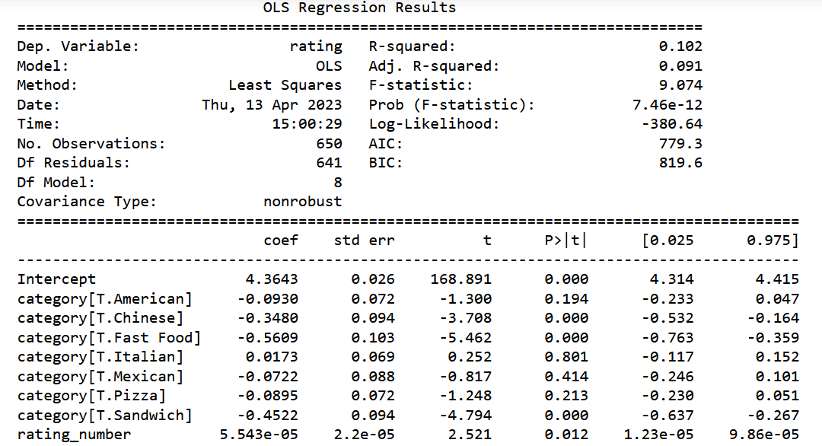
Regression
Google Maps
The rating, rating_number, and category are not correlated with each other for restaurants in PA in general since the r-squared is too small.
The results do not change for each city.

Slide 7
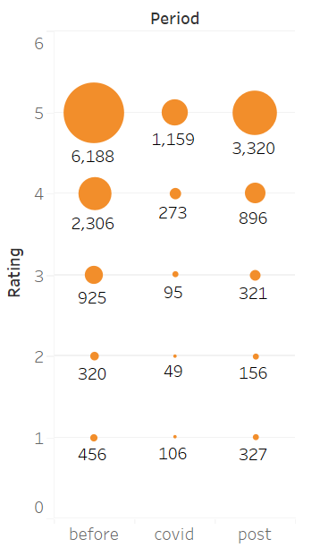
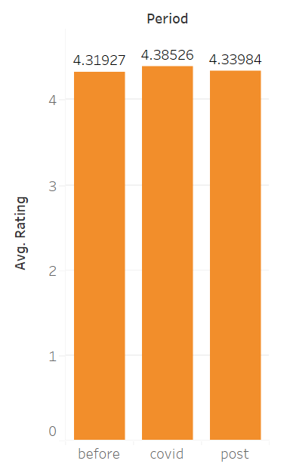
Impact of COVID-19

Slide 8
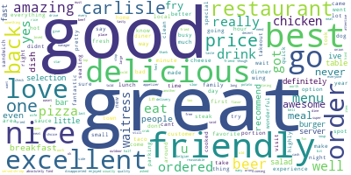
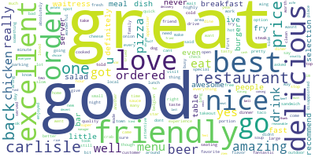
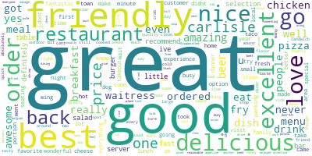
Word Clouds
(before, during, and after COVID-19)
before: 10195 comments
during: 1862 comments
after: 5020 comments

Slide 9
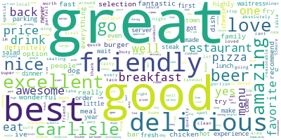
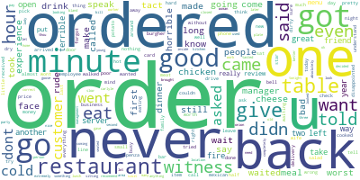
Word Clouds
(rating 1.0 vs. rating 5.0)

Slide 10
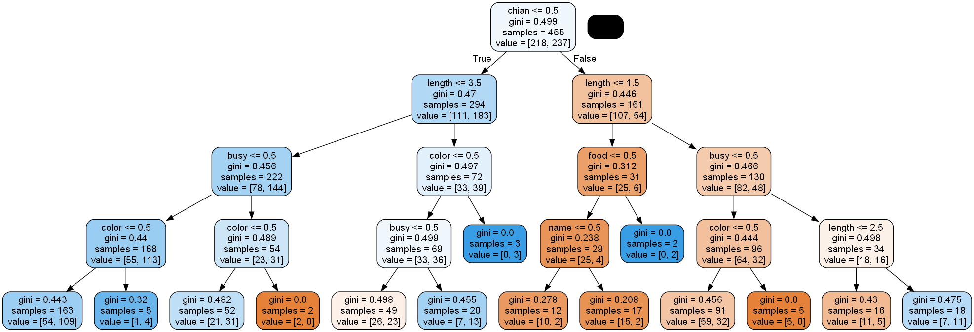
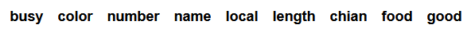
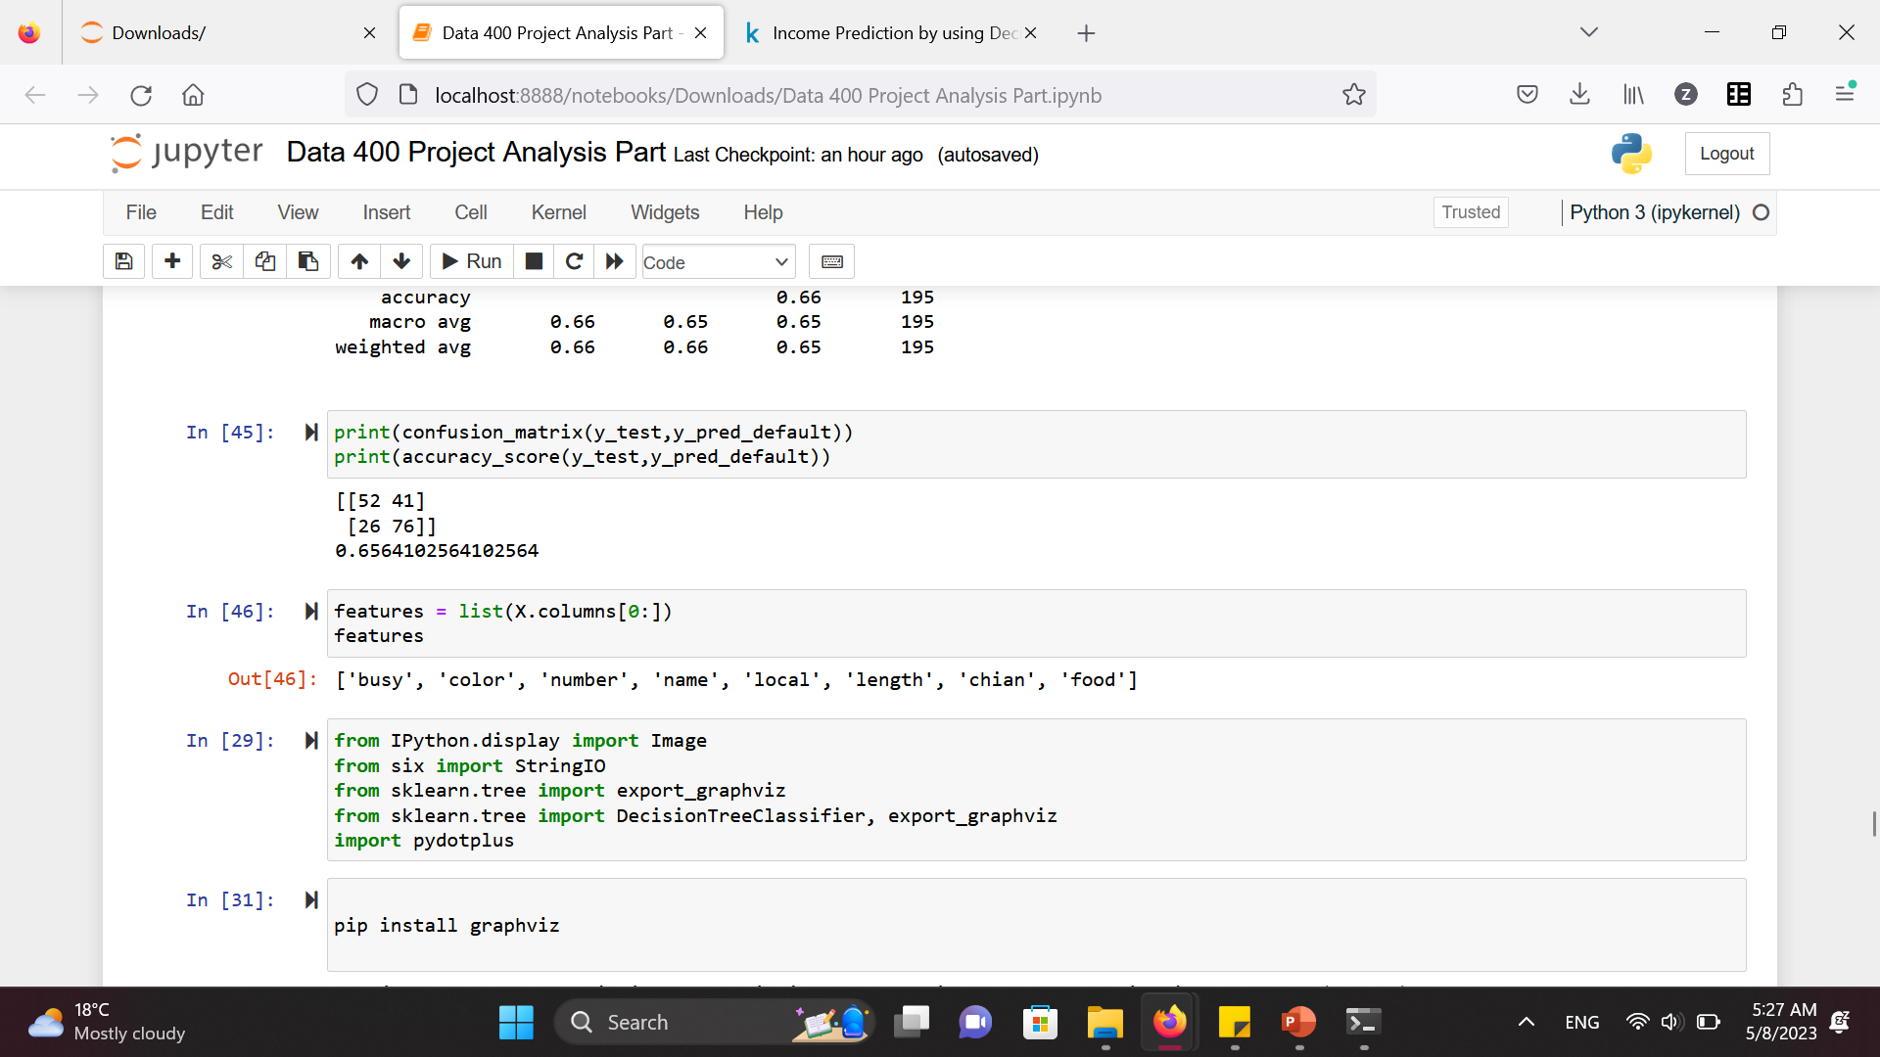
Decision Tree

Slide 11
Key Takeaways
Carlisle has the lowest quality among the 4 cities while Philly has the largest number of high-quality restaurants.
Rating, number of ratings, and category are not correlated.
COVID-19 did not negatively affect the rating of restaurants in PA. It even made the rating slightly higher.
People who left a 1.0 always complain about the length of the waiting time.
The name of restaurants can help with predicting the average rating.

Slide 12
Limitations & Ethical
Google Map (review & time)
Yelp has more info
Supervised Learning
Non-profit
New restaurants
Google Maps

Slide 13
Google Map
Thank you for listening!
Restaurants

